Slide 1


Quick Presentation Pointers
Mae Fahnestock

Slide 2

Presentation
Grammar/Vocabulary
2. PowerPoint
3. Rhetorical Questions for Yourself
* I have watched many of your practice presentations and came up with these points as you presented to the class.

Slide 3

Presentation
A presentation should be a conversation, not something you want to memorize: if you know it, then you can talk about it
Notice the speed of how you present. Watch Ted Talks, notice their times and how they present
It’s 8 minutes, it will fly by quickly!
Don’t be afraid to refer to your PowerPoint with your hands; don’t be afraid to walk across the smartboard to point to your picture – try not to reach across the smartboard
(Rooth, 2012)

Slide 4
Presentation
For those who solely rely on your flashcards, think about how it feels to be able to talk about a topic you know well
For those who try to memorize or present without using flashcards, think about your posture. How you are getting the audience full attention?
Think about yourself and audience because you know your topic well
It isn’t bad to use flashcards, just DON’T fully rely on them
Never assume that whoever is watching will know what something is: acronyms

Slide 5

Grammar/Vocabulary
Basic grammar rule: my group and I – NOT “me and my group”
Freshen up on your grammar rules! Please!
Try not to constantly say “um” or “like” or “err” - they know you’re nervous but if you know your presentation well, you will naturally minimize these vocalized pauses
Use words other than “because” and “and” – find synonyms
(Endurite, 2017)

Slide 6

PowerPoint
**A presentation should be a conversation, not something you want to memorize: if you know it, then you can talk about it
PowerPoints HELP enhance your presentation; it is not there for you to read off of
Presentations should be personal and passionate; it is a topic of YOUR choice
(Nelson, 2009)

Slide 7
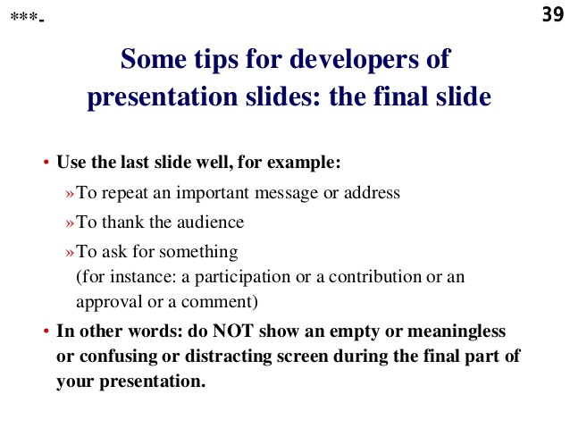
PowerPoint
Don’t be afraid to repeat a slide. Repeating helps your audience remember your point
Have someone point out what your reasons and solutions are
Validation: not too long, get to the point
(Chaudhary, 2017)

Slide 8



PowerPoint
Restate your reasons and solutions so the audience can easily identify your reasons and solutions – after an example, quickly tie it back to your reason
Source (citations) are too small – think about how it would be able to pick up on video
Explaining does not mean stating what is displayed on the slides
What’s the problem?
What’s the solution?
What’s the result?

Slide 9
Rhetorical Questions for Yourself
What did I do well?
How could I do better?

